Slide 1
Adaptive Artificial Intelligent
QA System
Group - 17-107

Slide 2
Introduction

Slide 3
A QA system for the growing information problem
High rate of information growth
QA system that can understand a given corpus.
Allow the user to ask questions in natural language form
Produce answers in natural language form
The high rate of growth of data means humans cannot keep up. A question answer system should be capable of operating in any domain.

Slide 4
Existing solutions
Natural Language Database Interfaces (NLDBIS) make use of NLP techniques to understand the question and to generate database queries to retrieve information from an underlying database.
Information Retrieval (IR) systems allow a user to make a query and the system is able to to return a document or a collection of artifacts that relate to the query
Template based question answering is another technique that has been used for QA and is currently being used by the START system which has answered over a million questions since 1993

Slide 5
Why our system? (Research Gap)
Previously highlighted systems have serious drawbacks such as:
Low accuracy
Needs a lot of manual preprocessing of the data to add to database
Creating question templates
Organising data documents and linking to questions
Many usability issues that keep these systems from becoming commercially viable
Users’ want to be able to use such systems seamlessly.
Use Deep Neural Network technologies to overcome these issues

Slide 6
What if users could ask questions in natural form and obtain answers in natural form, similar to conversing with a human?

Slide 7
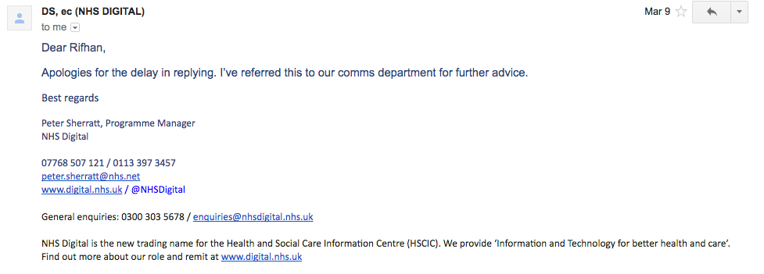
Proof of concept
Create a proof of concept for the medical emergency domain.
Request for the NHS ECDS dataset has been forwarded.
Use Keras on top of Tensorflow for the Deep Neural Networks.

Slide 8
Corpus
Pre-Processing
Notes:
Explain what is corpus preprocessing

Slide 9
Why Pre-Process Corpus
How to pre-process corpus
Word2vec vs GloVe
Summary of corpus pre-processing
Corpus contains unstructured raw, text data which can be understood by humans, not machines. Arises a need to transform such data into vectors.

Slide 10
How to Pre-Process Corpus
Punctuation removal
Eg: obesity vs obesity.
Transformation to lower case
Eg: OBESITY vs obesity
Stopwords removal
Eg: the, is, was, etc.
Merging multi-word terms
Eg: Human Immunodeficiency Virus transformed to human_immunodeficiency_virus
Reference: Dependency-Based Semantic Parsing for Concept-Level Text Analysis
Applying word embedding
Notes:
1.WH, comparison etc understand the type of the question
2.is a, part of, has a

Slide 11
word2vec vs GloVe
Both models, transforms vectors of words in a vector space with low dimension.
What is GloVe?
Count-based model - learn their vectors by essentially doing dimensionality reduction on the co-occurrence count
Semantic (sensible)
What is word2vec?
Predictive model - learn their vectors in order to improve their predictive ability
Semantic (sensible) and Syntactic (grammatical)
Notes:
1.WH, comparison etc understand the type of the question
2.is a, part of, has a

Slide 12
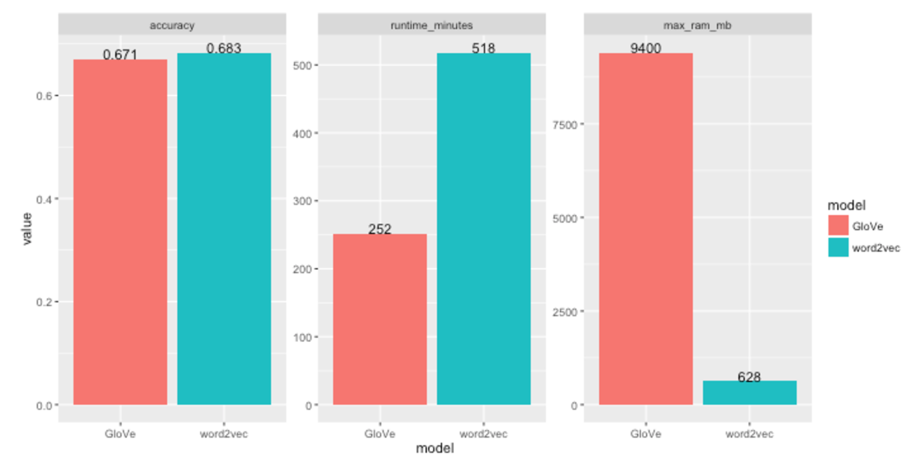
word2vec vs GloVe
https://github.com/piskvorky/word_embeddings
Notes:
1.WH, comparison etc understand the type of the question
2.is a, part of, has a

Slide 13
Summary of Corpus Pre-Processing
Notes:
1.WH, comparison etc understand the type of the question
2.is a, part of, has a

Slide 14
Question Pre-Processing

Slide 15
Why Pre-Process Questions ?
Garbage text removal
Vector representation
Wh analysis
Questions can be open ended and asked in many different forms, our goal is to simplify the question and present it in a form that the DNN can process
Notes:
Users can ask questions in many different forms some of the terms used in the question are not all relevant to the context of the question
The question must be represented in a vector space so that the DNN can process it

Slide 16
Approach
Garbage Text Removal
Eg - Help me with the rash in my hand ?
Requires Syntactic and Semantic Analysis
Wh Analysis
Questions can be asked in different forms
Eg - What, Who, How, Where
Vital for answer generation
Vector Representation
Neural Networks can only process numbers
Question is represented in a vector space preserving its context and semantics
Syntactic Analysis
Stanford Parser
Word Embedding
Word2Vec / Glove
Reference - Exploring Question Understanding and Adaptation in Neural-Network-Based Question Answering by Junbei Zhang1 , Xiaodan Zhu2 , Qian Chen1 , Lirong

Slide 17
Unified Embedding Techniques
Why Does Corpus Pre-Processing and Question Preprocessing use the same embedding technique ?
DNN depends on the pre processed corpus to extract the answer - knowledge base
DNN depends on the pre processed question to identify the exact answer - Information base
Reference - Exploring Question Understanding and Adaptation in Neural-Network-Based Question Answering by Junbei Zhang1 , Xiaodan Zhu2 , Qian Chen1 , Lirong

Slide 18
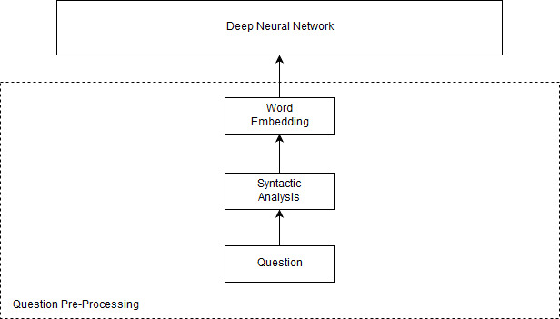
Overall Approach
Reference - Exploring Question Understanding and Adaptation in Neural-Network-Based Question Answering by Junbei Zhang1 , Xiaodan Zhu2 , Qian Chen1 , Lirong

Slide 19
DNN for Answer Extraction

Slide 20
What is Answer Extraction
Here what we are trying to do is generate answer by looking at the pre-structured dataset.
Identify the pattern of the question asked.
Identify the relationships between entities.
Generate an accurate unstructured answer.
Notes:
1.WH, comparison etc understand the type of the question
2.is a, part of, has a

Slide 21
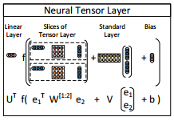
Why Deep Neural Networks
Drawbacks in other alternatives such as ontologies and knowledge bases.
Ability to recognize complex hidden patterns and relationships.
Can handle complex tensor data flows.
Possible candidate would be Neural Tensor Networks.
Notes:
Drawback: inability to reason over relationship between multiple entities

Slide 22
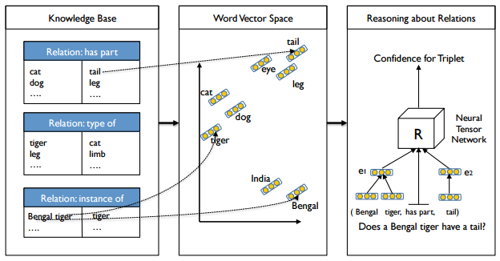
How it works
Reference - Reasoning With Neural Tensor Networks for Knowledge Base Completion by Richard Socher∗ , Danqi Chen*, Christopher D. Manning, Andrew Y. Ng

Slide 23
Answer Generation

Slide 24
Why ‘Answer Generation’?
Because of user friendliness..
One of the key points in this system is that it would be user friendly. This means the user must be able to use the system as if they were interacting with a person.
Because it is a key point that is yet to be addressed by other systems..
The objective of this component is to generate answers in natural language form after the correct answer has been identified.

Slide 25
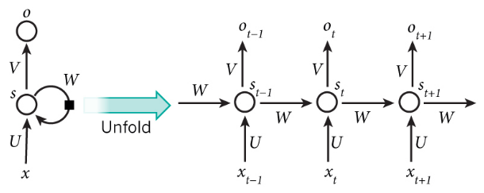
Recurrent Neural Networks
Usually deep neural networks are used to identify patterns and are used as predictive models. In this case the DNN must be used as a generative model instead
Limited research done into a system using a recursive auto encoder model. The most promising research has used a RNN.
RNN’s are capable of forming a time series which makes them ideal for forecasting information. A well trained RNN could be capable of predicting the next character in a sequence of characters.
Reference - "Recurrent Neural Networks Tutorial, Part 1 – Introduction to RNNs", WildML, 2017. [Online]. Available: http://www.wildml.com/2015/09/ recurrent-neural-networks-tutorial-part-1-introduction-to-rnns/.
Notes:
"Recurrent Neural Networks Tutorial, Part 1 – Introduction to RNNs", WildML, 2017. [Online]. Available: http://www.wildml.com/2015/09/recurrent-neural-networks-tutorial-part-1-introduction-to-rnns/.

Slide 26
Expected outcome
Existing research done by Andrej Karpathy has created a successful RNN that is capable of generating such text using a neural net called Char-RNN.
Question : When was Sri Lanka railways founded?
Identified answer sentence : Sri Lanka railways has not been profitable since
it was founded in 1858
Primetext : Sri Lanka railways founded 1858
Expected output : Sri Lanka railways was founded in 1858

Slide 27
What if users could ask questions in natural form and obtain answers in natural form, similar to conversing with a human?

Slide 28
Appendix

Slide 29
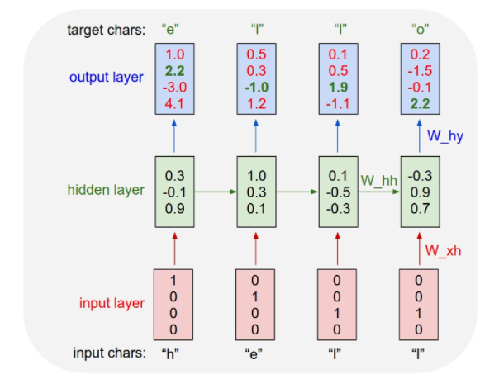
Char-RNN
The following diagram depicts a RNN that is being trained on a language model of four letters (‘E’, ‘H’, ‘L’, ‘O’) to generate the word ‘hello’
This can be extended to a vocabulary of entire words.

